Slide 1
Toward Controlled Generation of Text

Slide 2
Main contributions
In this paper we tackle the problem of controlled generation of text. That is, we focus on generating realistic sentences, whose attributes can be controlled by learning disentangled latent representations.

Slide 3
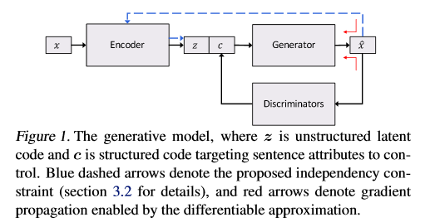
Architecture

Slide 4
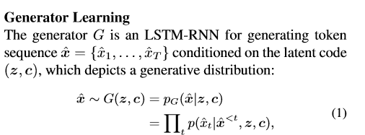



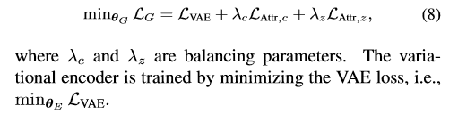
LSTM generator
Loss function

Slide 5
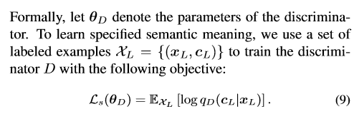
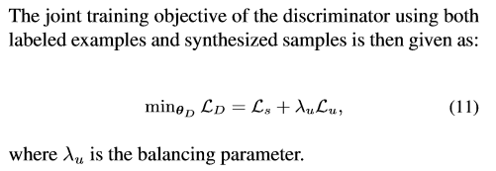
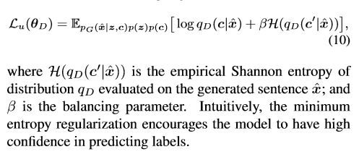
Discriminator
Loss function

Slide 6
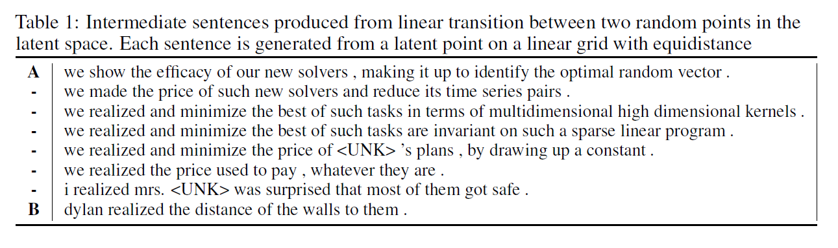
Result

Slide 7
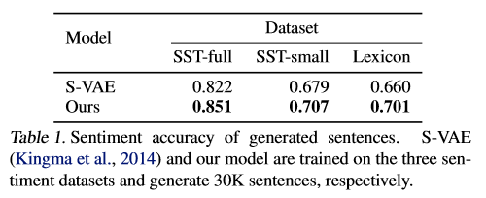
Result

Slide 8
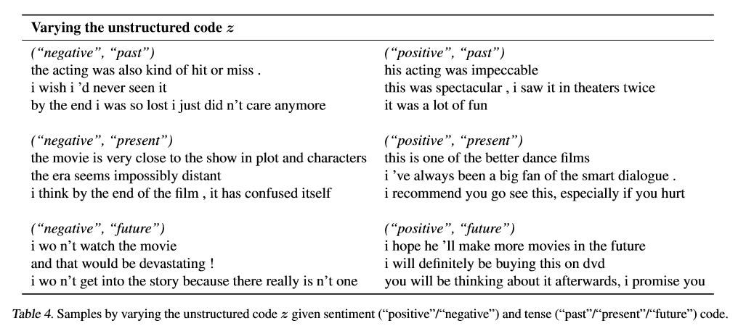
Result

